Slide 1

MedCommons
The World of Medical Imaging on your PACS.
V 0.3
April 6, 2004
CONFIDENTIAL

Slide 2
A new kind of national medical image management service accessible to physicians, institutions and patients alike.

Slide 3
6 Problems
How would the lab at Hospital X process this study?
Send this CT to Dr Jones in Miami?
Is this radiation treatment right for me?
Why can’t I use my workstation to view studies from outside the PACS?
Who will store medical images from my different doctors?
Can I add this new workstation to my PACS workflow?

Slide 4
PACS
Today
Single-Vendor
Proprietary Workstations
Long Upgrade Cycles
Expensive Customization
Isolated
Out of MD Control
+ MedCommons
Bridges Vendors
Works with the PACS Workstation
Install it in Minutes
“Plug-in” a Service
Not Isolated
Physician / Patient Control

Slide 5


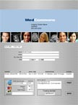
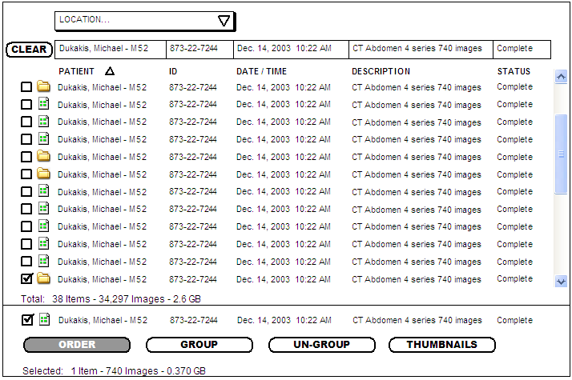
Using MedCommons
DICOM
PACS
Workstation
Modality
Operator
MedCommons
1
2
Annotate &
Authorize
Search &
Click
Web Services
CCOW
DICOM Selection Screen
MedCommons Order Form

Slide 6
What does MedCommons add to IHE and PACS?
A centralized HIPAA Log that simplifies Business Associate collaboration;
Signed, FDA 21CFR-11 documented transactions between Business Associates;
Archival, institutionally-neutral storage;
Shared and secure user, facility and medical protocol profiles;
Centralized tracking and support;
Optional credit card transactions.

Slide 7
Designed to be a Service
No installation fee – (Pay-to-Use)
Install from the Web in minutes.
Send to/from any DICOM device or network.
Secure…
  FDA 21CFR Part 11
  ISO 13485-2003
  HIPAA Compliant with Secure Central Log
Institutionally Neutral
Promote Standards and Open Source Software

Slide 8
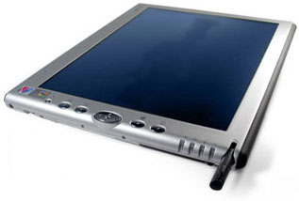
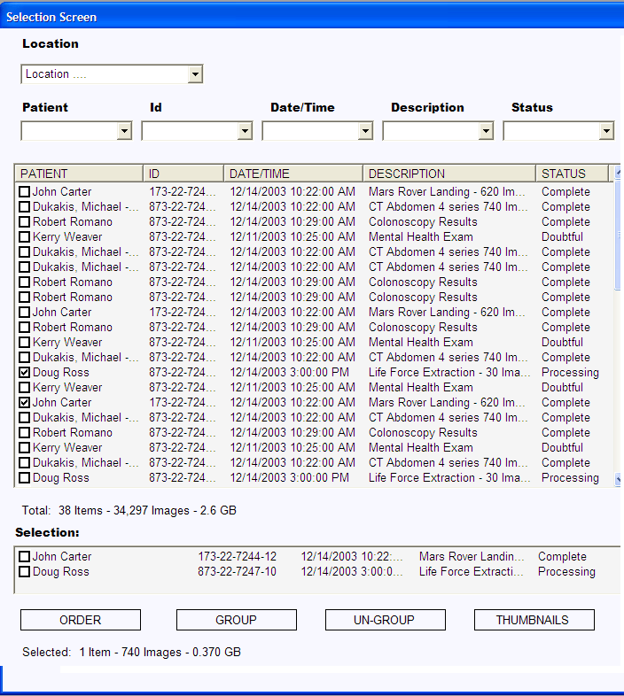
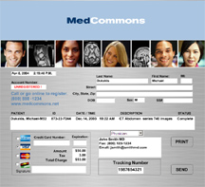
Easy as 1, 2, 3…
1
Get a MedCommons Tablet or install from the Web.
Pick a Study
Choose a destination and pay.
2
3

Slide 9
Flexible Access…
MedCommons Tablet
  Wired
  Wireless (Verizon 3G)
  Credit Card Accessory
Your Desktop PC / Mac
  Web Browser – “zero” Install
  Native Application – Web Install
Your DICOM Workstation
  Web Install
Telephone & Fax

Slide 10
Promote Integration…
IHE Throughout
  CCOW Coming Soon
Install directly on a DICOM Workstation
Link into Patient Portals
HIPAA Logs & Agreements
  Managed by MedCommons
Archival Storage is automatic & included.

Slide 11
Unique Approach
FDA Registered, Open Source IHE Software
Centralized Management and Support
Banking-grade Security
Equally Accessible to:
  Physicians
  Institutions
  Patients

Slide 12
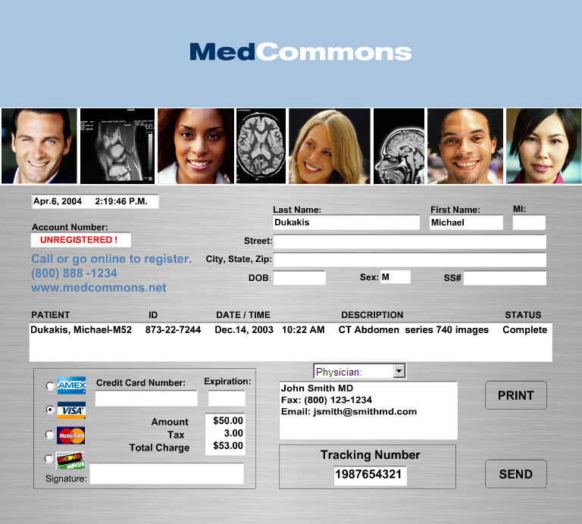
The Order Form is Central

Slide 13
Order Form
Automatically personalized with patient and physician information.
Can include credit card charge capture.
Legally binding with signature in digital or handwritten form.
MedCommons will process forms via Web, IHE requests, and Fax…
… some Forms can be printed and Mailed to MedCommons.

Slide 14
Register with MedCommons
Register On-Line or by Fax
Order a Tablet or Install Software
  No install required for viewing only.
Tell your colleagues and patients
Send DICOM studies to MedCommons
Authorize viewing, processing and return updates anytime.
Track everything at MedCommons Online

Slide 15
Benefits
Service patients and referring physicians directly.
Use your existing workstation or add the workstation of your choice.
Access the latest CAD and screening services worldwide.
MedCommons takes care of storage, HIPAA, support and payment.

